Slide 1
Magnetic Test
DFH SATELLITE CO.,LTD
February. 2019

Slide 2
Content
What is Magnetic
Earth's magnetic field
Magnetic Test Detail
Magnetic Test Example
Exercise

Slide 3
Content
What's Magnetic
Earth's magnetic field
Magnetic Test Detail
Magnetic Test Example
Exercise

Slide 4
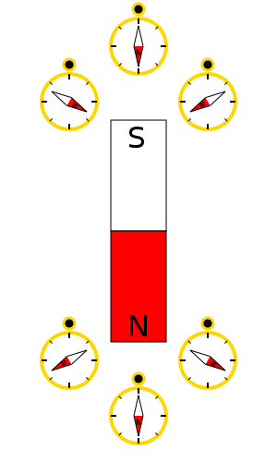
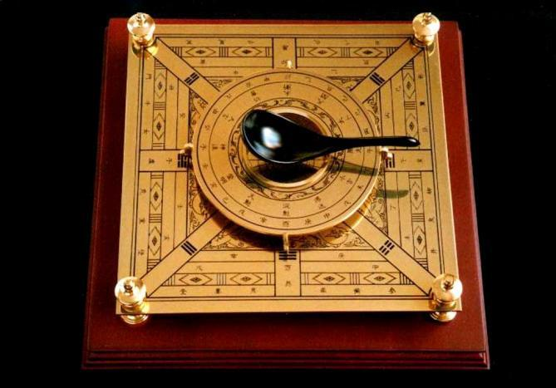
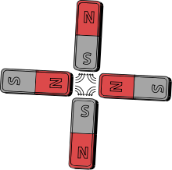
What is Magnetism
Fundamental Knowledge
What is magnetism？
Magnetism is a class of physical phenomena that are mediated by magnetic fields. Electric currents and the magnetic moments of elementary particles give rise to a magnetic field, which acts on other currents and magnetic moments.
All matters are magnetic
Compass 司南

Slide 5
What is Magnetism
Fundamental Knowledge
Magnetism, at its root, arises from two sources:
1. Electric current , Movement of electric charge
2. Matter Magnetism: Spin magnetic moments of elementary particles. The magnetic moments of the nuclei of atoms are typically thousands of times smaller than the electrons' magnetic moments, so they are negligible in the context of the magnetization of materials. Nuclear magnetic moments are nevertheless very important in other contexts, particularly in nuclear magnetic resonance (NMR) and magnetic resonance imaging (MRI).
Movement of electric charge:
Magnetic moment: unit: A ∙m²
The magnetic moment represent the magnitude of the magnetic field produced by current carrying coil, and it can be introduced to microscopic system of matter.

Slide 6
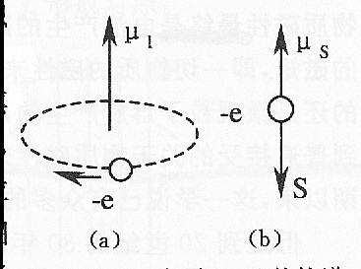
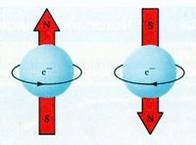
What is Magnetism
Fundamental Knowledge
Matter magnetism
It is believed that the magnetism of matter is coming from the magnetism of atom.
The orbital magnetic moment of outer electron in atom
The spin magnetic moment of electron
The spin magnetic moment of atomic nucleus
Note: The atomic nucleus' spin magnetic moment is 1/1836.5 of the electron's magnetic moment which means it is negligible.

Slide 7
What is Magnetism
Fundamental Knowledge
Why the matter is nonmagnetic in common state?
The atomic inherent magnetic moment is exist for the atoms of most element which is the composite magnetic moment of the summation of orbital and spin magnetic moment for every electrons following the atom structure and quantum-mechanics laws.
The matter's magnetism is depend on the orientation of atomic magnetic moment.
The magnetic moment orientation of every atoms is disarranged when there is no external magnetic field effect existing and the matter is macroscopy nonmagnetic.
The atomic magnetic moment orientation shall be arranged when the matter is effected by external magnetic field and the matter is macroscopy magnetic.

Slide 8
What is Magnetism
Fundamental Knowledge
Classification of magnetic matter
Append magnetic induction intensity
Total magnetic induction intensity
External magnetic induction intensity
The Unit of magnetic induction intensity: 1T=1000mT=10⁹nT=10⁴Gs

Slide 9
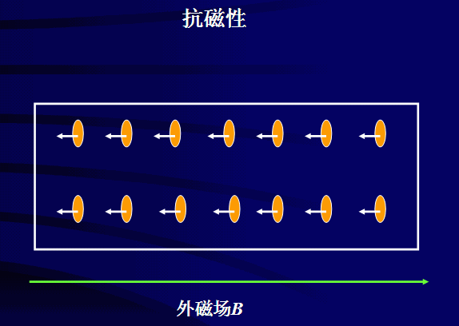
What is Magnetism
Fundamental Knowledge
Diamagnet: The Append magnetic induction intensity is opposite to the external magnetic field. Diamagnetic materials are repelled by a magnetic field; an applied magnetic field creates an induced magnetic field in them in the opposite direction, causing a repulsive force. Magnetic susceptibility χ: χ<0，｜χ｜<<1
Inert Gases(Noble Gases): He, Ne, Ar, Kr, Xe
Majority Nonmetal and minority Metal: Si, Ge, S, P, Cu, Ag, Au
Ionic Crystal without Transition Elements: NaCl, KBr
covalent bond compound without Transition Elements: H₂, CO₂, CH₄
Nearly all organic compounds and biological tissue: H₂O

Slide 10
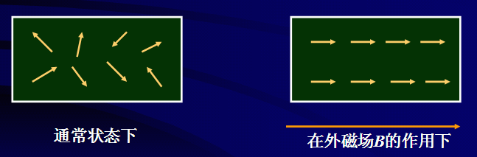
What is Magnetism
Fundamental Knowledge
Paramagnet: Paramagnetism is a form of magnetism whereby certain materials are attracted by an externally applied magnetic field, and form internal, induced magnetic fields in the direction of the applied magnetic field. Paramagnetic materials have a small, positive susceptibility to magnetic fields. These materials are slightly attracted by a magnetic field and the material does not retain the magnetic properties when the external field is removed. Magnetic susceptibility χ : 0<χ<<1
Transition Elements: Sc, Zr, Mo
Rare Earth elements: La, Ce, Pr, Nd, Pm, Sm, Eu, Gd, Tb, Dy, Ho, Er, Tm, Yb, Lu
Actinide elements metal: Ac, Th, Pa, U, Np, Pu, Am, Cm, Bk, Cf, Es, Fm, Md, No, Lr
Alkali metal: Li, Na, K, Rb, Cs, Sr
Alkaline-earth metals: Be, Mg, Ca, Sr, Ba, Ra, Ubn
Aluminium

Slide 11
What is Magnetism
Fundamental Knowledge
Ferromagnet: Ferromagnetism is the basic mechanism by which certain materials (such as iron) form permanent magnets, or are attracted to magnets. In physics, several different types of magnetism are distinguished. Ferromagnetism is the strongest type: it is the only one that typically creates forces strong enough to be felt, and is responsible for the common phenomena of magnetism in magnets encountered in everyday life. Substances respond weakly to magnetic fields with three other types of magnetism, paramagnetism and diamagnetism, but the forces are usually so weak that they can only be detected by sensitive instruments in a lab.
Permanent magnets (materials that can be magnetized by an external magnetic field and remain magnetized after the external field is removed) are either ferromagnetic or ferrimagnetic, as are the materials that are noticeably attracted to the, m. Only a few substances are ferromagnetic. The common ones are ironnickel, cobalt and most of their alloys, some compounds of rare earth metals. Magnetic susceptibility χ : χ>>1

Slide 12
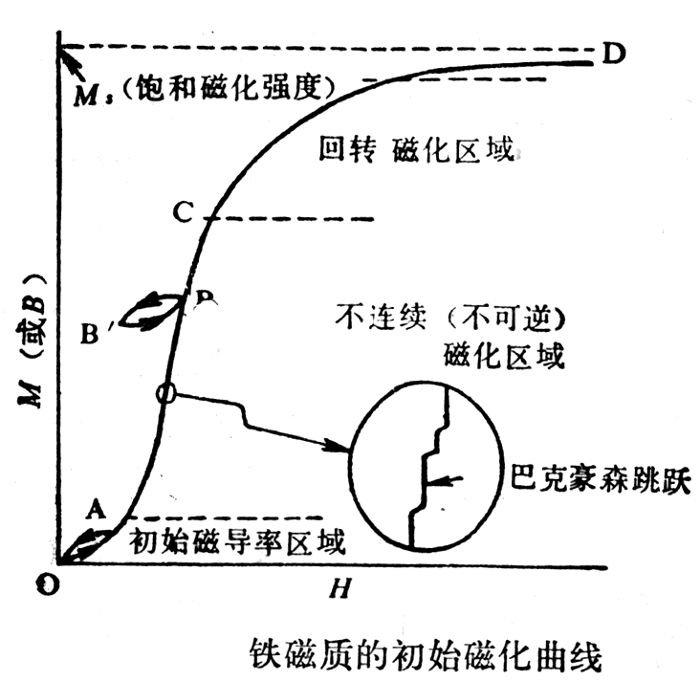
What is Magnetism
Fundamental Knowledge
The magnetization Curve (B-H Curve) is a basic curve of material magnetic characteristics with some basic magnetic parameters like Saturation Magnetization M_{s}, Initial magnetic susceptibility χ_{a} and saturation magnetic susceptibility χ_{m} , Barkhausen Jump etc.
B-H Curve of iron:

Slide 13
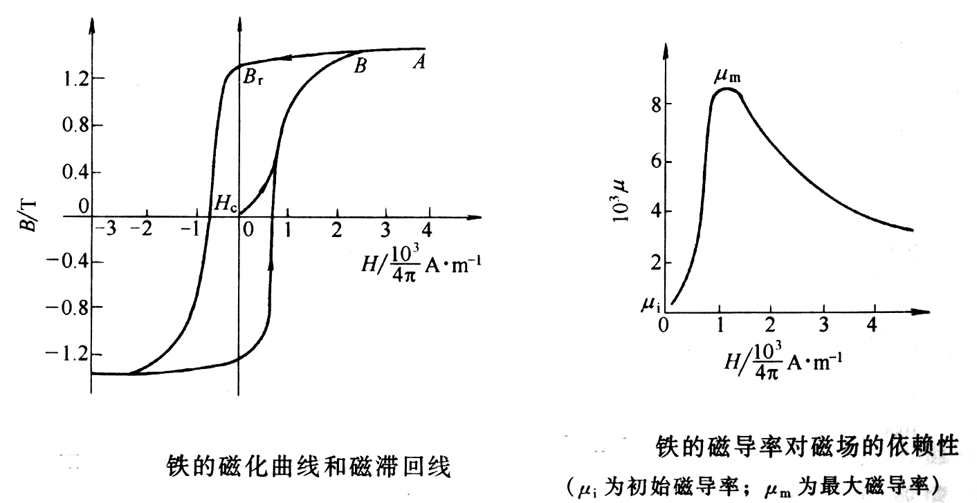
What is Magnetism
Fundamental Knowledge
When a ferromagnetic material is magnetized in one direction, it will not relax back to zero magnetization when the imposed magnetizing field is removed. It must be driven back to zero by a field in the opposite direction. If an alternating magnetic field is applied to the material, its magnetization will trace out a loop called a hysteresis loop. The lack of retraceability of the magnetization curve is the property called hysteresis and it is related to the existence of magnetic domains in the material. Once the magnetic domains are reoriented, it takes some energy to turn them back again. This property of ferrromagnetic materials is useful as a magnetic "memory". Some compositions of ferromagnetic materials will retain an imposed magnetization indefinitely and are useful as "permanent magnets".

Slide 14
Content
What's magnetic
Earth's magnetic field
Magnetic Test Detail
Magnetic Test Example
Exercise

Slide 15
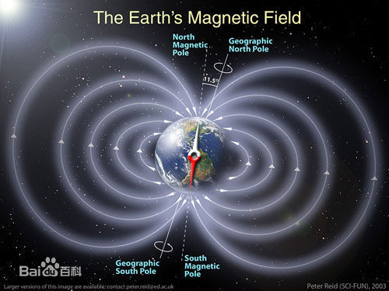
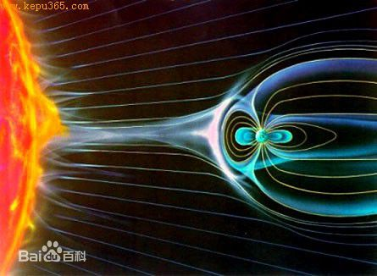
Earth's magnetic field
2.1 Summary
Earth's magnetic field, also known as the geomagnetic field, is the magnetic field that extends from the Earth's interior out into space, where it meets the solar wind, a stream of charged particles emanating from the Sun. Its magnitude at the Earth's surface ranges from 25 to 65 microteslas (0.25 to 0.65 gauss).

Slide 16
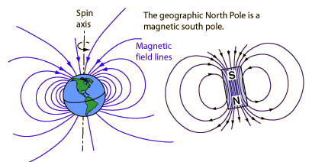
Earth's magnetic field
2.1 Summary
Roughly speaking it is the field of a magnetic dipole currently tilted at an angle of about 10 degrees with respect to Earth's rotational axis, as if there were a bar magnet placed at that angle at the center of the Earth. The North geomagnetic pole, located near Greenland in the northern hemisphere, is actually the south pole of the Earth's magnetic field, and the South geomagnetic pole is the north pole.
Unlike a bar magnet, Earth's magnetic field changes over time because it is generated by a geodynamo (in Earth's case, the motion of molten iron alloys in its outer core).

Slide 17
Earth's magnetic field
2.1 Summary
While the North and South magnetic poles are usually located near the geographic poles, they can wander widely over geological time scales, but sufficiently slowly for ordinary compasses to remain useful for navigation.
However, at irregular intervals averaging several hundred thousand years, the Earth's field reverses and the North and South Magnetic Poles relatively abruptly switch places. These reversals of the geomagnetic poles leave a record in rocks that are of value to paleomagnetists in calculating geomagnetic fields in the past. Such information in turn is helpful in studying the motions of continents and ocean floors in the process of plate tectonics.

Slide 18
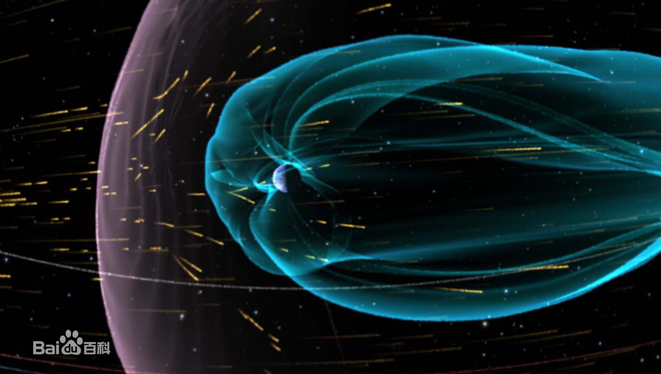
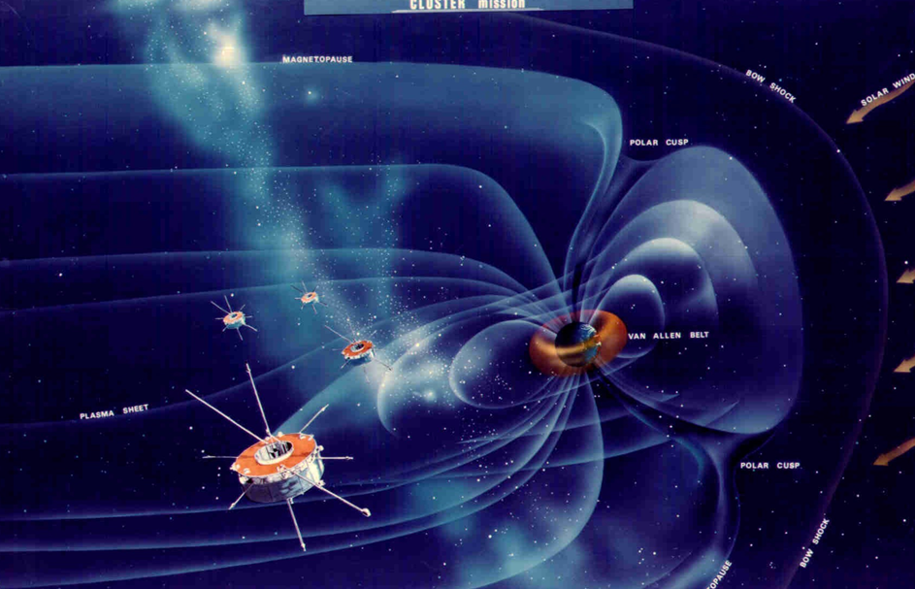
Earth's magnetic field
2.1 Summary
The magnetosphere is the region above the ionosphere that is defined by the extent of the Earth's magnetic field in space. It extends several tens of thousands of kilometers into space, protecting the Earth from the charged particles of the solar wind and cosmic rays that would otherwise strip away the upper atmosphere, including the ozone layer that protects the Earth from harmful ultraviolet radiation.

Slide 19
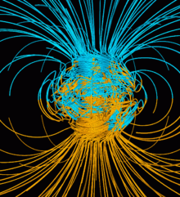
Earth's magnetic field
2.1 Summary
The magnetosphere is the region above the ionosphere that is defined by the extent of the Earth's magnetic field in space. It extends several tens of thousands of kilometers into space, protecting the Earth from the charged particles of the solar wind and cosmic rays that would otherwise strip away the upper atmosphere, including the ozone layer that protects the Earth from harmful ultraviolet radiation.
Computer simulation of the Earth's field in a period of normal polarity between reversals. The lines represent magnetic field lines, blue when the field points towards the center and yellow when away. The rotation axis of the Earth is centered and vertical. The dense clusters of lines are within the Earth's core.

Slide 20
Earth's magnetic field
2.1 Summary
The Earth's magnetic field is similar to that of a bar magnet tilted 11 degrees from the spin axis of the Earth. The problem with that picture is that the Curie temperature of iron is about 770 C . The Earth's core is hotter than that and therefore not magnetic. So how did the Earth get its magnetic field?
Magnetic fields surround electric currents, so we surmise that circulating electric currents in the Earth's molten metalic core are the origin of the magnetic field. A current loop gives a field similar to that of the earth. The magnetic field magnitude measured at the surface of the Earth is about half a Gauss and dips toward the Earth in the northern hemisphere. The magnitude varies over the surface of the Earth in the range 0.3 to 0.6 Gauss.

Slide 21
Earth's magnetic field
2.2 Physical origin
The Earth's magnetic field is believed to be generated by electric currents in the conductive material of its core, created by convection currents due to heat escaping from the core. However the process is complex, and computer models that reproduce some of its features have only been developed in the last few decades.
The Earth and most of the planets in the Solar System, as well as the Sun and other stars, all generate magnetic fields through the motion of electrically conducting fluids. The Earth's field originates in its core. This is a region of iron alloys extending to about 3400 km (the radius of the Earth is 6370 km). It is divided into a solid inner core, with a radius of 1220 km, and a liquid outer core.

Slide 22
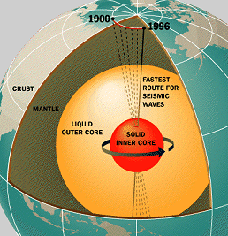
Earth's magnetic field
2.2 Physical origin
The motion of the liquid in the outer core is driven by heat flow from the inner core, which is about 6,000 K (5,730 °C; 10,340 °F), to the core-mantle boundary, which is about 3,800 K (3,530 °C; 6,380 °F). The pattern of flow is organized by the rotation of the Earth and the presence of the solid inner core.
At the heart of our planet lies a solid iron ball, about as hot as the surface of the sun. Researchers call it "the inner core." It's really a world within a world. The inner core is 70% as wide as the moon. It spins at its own rate, as much as 0.2º of longitude per year faster than the Earth above it, and it has its own ocean: a very deep layer of liquid iron known as "the outer core."

Slide 23
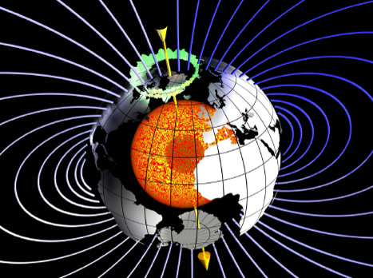
Earth's magnetic field
2.3 Magnetosphere
Some of the charged particles do get into the magnetosphere. These spiral around field lines, bouncing back and forth between the poles several times per second. In addition, positive ions slowly drift westward and negative ions drift eastward, giving rise to a ring current. This current reduces the magnetic field at the Earth's surface. Particles that penetrate the ionosphere and collide with the atoms there give rise to the lights of the aurorae and also emit X-rays.

Slide 24
Earth's magnetic field
2.3 Magnetosphere
The varying conditions in the magnetosphere, known as space weather, are largely driven by solar activity. If the solar wind is weak, the magnetosphere expands; while if it is strong, it compresses the magnetosphere and more of it gets in. Periods of particularly intense activity, called geomagnetic storms, can occur when a coronal mass ejection erupts above the Sun and sends a shock wave through the Solar System. Such a wave can take just two days to reach the Earth. Geomagnetic storms can cause a lot of disruption; the "Halloween" storm of 2003 damaged more than a third of NASA's satellites. The largest documented storm occurred in 1859. It induced currents strong enough to short out telegraph lines, and aurorae were reported as far south as Hawaii.

Slide 25
Earth's magnetic field
Fundamental Knowledge
Magnetic field Consideration for different orbits
Region | Planet | Magnetic field intensity | Note
Earth magnetic field | LEO, MEO | 10000~60000 nT | Should be concerned about
 | GEO | Several hundreds
Interplanetary |  | Less than 10 nT | Especially for science explore
Exoplanet | Moon | About 100 nT | Depend on magnetic requirement of the satellite
 | Venus | 1/100 of Earth magnetic field
 | Jupiter | 10 times of Earth magnetic field
 | Mercury | Very weak
 | Mars | Nearly nonmagnetic

Slide 26
Content
What's magnetic
Earth's magnetic field
Magnetic Test Detail
Magnetic Test Example
Exercise

Slide 27
Magnetic Test Detail
3.1 Introduction.
All torques that tend to disturb the attitude of a spacecraft must be considered in the design of spacecraft attitude control systems. One of these torques, the magnetic torque resulting from the interaction between the magnetic properties of the spacecraft and the ambient magnetic field, is the subject of this lecture.
Determination of the magnetic torque requires knowledge of the strength and direction of the ambient magnetic field, the magnetic dipole moment of the spacecraft, and the orientation of this dipole relative to the local magnetic field vector.
Current loops and materials subject to permanent or induced magnetism are the primary sources of magnetic torques, but eddy current and hysteresis effects can be appreciable when the spacecraft or portions thereof rotate rapidly in the magnetic field.

Slide 28
Magnetic Test Detail
3.1 Introduction.
Magnetic disturbance torque is one of the factors that must be considered in the determination of spacecraft attitude motion, control actuator sizing, expendable fuel requirements, and spin decay. Minimization of magnetic disturbance torques is particularly important when the available torques for control are small, e.g., gravity stabilization, or when small disturbances acting over a long period of time may introduce significant effects, such as precession of the spin axis of spin-stabilized spacecraft. Magnetic disturbance torque will not be a significant problem in spacecraft attitude control system design if the ambient field is negligibly small or if the spacecraft is designed to be magnetically“clean” for reasons other than control consideration, e.g., when sensitive magnetometers are present.

Slide 29
Magnetic Test Detail
3.1 Introduction.
There are three design considerations associated with magnetic disturbance torques: (l) assessment of the magnitude of the torque; (2) determination of an acceptable magnitude; and(3) control over the spacecraft magnetic characteristics during design and development to assure achievement of an acceptably low magnetic disturbance torque.
Determination of acceptable magnetic torque levels is primarily a Systems decision and requires consideration of attitude control system design, mission requirements, and other sources of disturbance torques(solar radiation, aero dynamic interactions, gravity effects, man and equipment motion, fuel sloshing, etc.)

Slide 30
Magnetic Test Detail
3.2 Flight Experience
The effect of a magnetic disturbance torque was observed on Vanguard l. This satellite was despun by the interaction of the Earth's magnetic field with eddy currents generated in the Satellite's rotating outer shell. As a result of this magnetic disturbance torque, the spin rate was reduced from an initial value of 2.7 revolutions per second (rps)at launch to less than 0.2 rps 2 years later.
Another type of magnetic disturbance torque was observed on the Tiros I. In this instance a substantial magnetic dipole moment in the satellite, interacting with the Earth's magnetic field, caused the spin axis to precess and resulted in unpredicted changes in orientations of the meteorological cameras relative to the Earth.

Slide 31
Magnetic Test Detail
3.2 Flight Experience
Both of the effects described in the preceding paragraphs have more recently also been applied for useful purposes. For example, the Transit IB and Transit 2A satellites were deliberately and rapidly despun employing, in principle, the same type of magnetic torque that decreased the rotation rate of Vanguard I. Transit IB also utilized a permanent magnetic dipole to stabilize the satellite's symmetry axis along the local direction of the Earth's magnetic field.
Similarly, by the use of ground-controlled variations of the magnetic moment of more recent Tiros satellites, accurate control of the orientation of meteorological cameras was achieved.

Slide 32
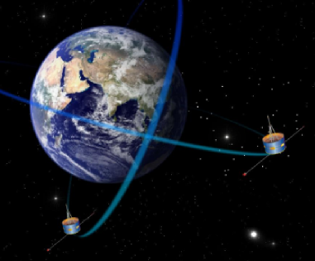
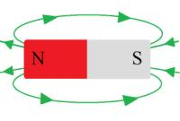
Magnetic Test Detail
Spacecraft Magnetic Control
The reason of magnetic control
1. The effect to the attitude control of satellite
2. The disturbance to the magnetic sensitive devices
magnetometer

Slide 33
Magnetic Test Detail
Spacecraft Magnetic Control
Control of Spacecraft Magnetic
Control of magnetic moment
Control of magnetic field
（a）LEO: small satellite: ≤ 1 A∙m²; large satellite: ≤ 5 A∙m²;
（b） MEO: small platform satellite: ≤ 5 A∙m²; large platform satellite: ≤ 15 A∙m²;
（c）GEO: Generally no request, except for long-life high-reliability satellite which is not larger than 15 A∙m²;
（d） interplanetary spacecraft: Generally no request.
1 m²
1A

Slide 34
Magnetic Test Detail
Spacecraft Magnetic Control
Source of Spacecraft Magnetic
Magnetic Material
Current Loop
（a）Hard magnetic-High coercivity
Relay, Traveling-wave tube, Magnetic recorder, Disconnector, Motor, Momentum wheel, Gyroscope, Electromagnetic valve, Transformer, Inductor.
（b） Soft magnetic-Low coercivity
Electric coupler, Fastener, Nickel battery, Gear, Bearing, Strut member, Metal sealing element, Attitude control engine, Magnetic torque.

Slide 35
Magnetic Test Detail
Spacecraft Magnetic Control
Source of Spacecraft Magnetic
Magnetic Material
Current Loop
Cable system on satellite
electric circuit inside devices
Coil in transformer, inductor, inductance
Power wiring
Grounding circuit current
Solar Battery array wiring
solenoid
thermoelectric couple circuit current

Slide 36
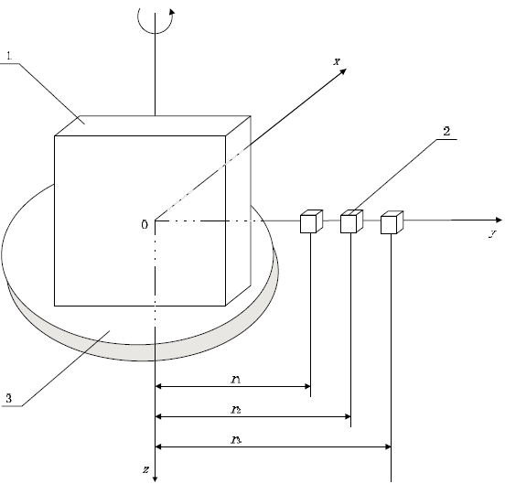
Magnetic Test Detail
3.3 Mapping on Equator
Assume the testing item is a magnetic central dipole system, the magnetic moment can be obtained by the data processing of the magnetic field intensity distribution at several circles of different radii on the equator plane of spacecraft.
To avoid the disturbance of the Earth’ field, the test system must be mounted on the field-free regions or the magnetic ambient field intensity must be subtract from the measured value of the 3 magnetometer. Field-free regions are produced by shielded magnetic enclosures or by coil arrangements that cancel the ambient field.
1- Spacecraft; 2- Magnetometer
3- Turning table; X-y plane - Equator plane
Z axis - Rotation axis

Slide 37
Magnetic Test Detail
3.3 Mapping on Equator
The test procedure is:
(l) Place 3 magnetometers along the y axis with the same distance between each other, make sure that the line connect the 3 magnetometers must across the geometry center of the test item and is perpendicular to the rotation axis.
(2) record the measured value of 3 magnetometers every rotation angle α while the test item is rotated along the Z axis in counterclockwise direction until the rotation angle of the test item has achieve 360°.
(3)using the measured magnetic field intensity data to calculate the magnetic moment of the test item.

Slide 38
Magnetic Test Detail
3.3 Mapping on Equator
Factors that contribute errors in the measurement are:
(l) resolution of magnetometers;
(2) distance and angle measurement error;
(3) magnetic field disturbance of external ambient magnetic field;
Under carefully controlled conditions, a resolution of 0.001 to 0.005 Am² (1 to 5 pole-cm) in measuring components of M can be obtained.
There are presently 2 magnetic test systems (CM1, CM2) available at CAST for the measurement of magnetic dipole moment M. The capacities of CM2 are the satellites which mass is 1000 kg or even lager.

Slide 39
Magnetic Test Detail
3.4 Test purpose
Obtain the magnetic characteristics such as static and dynamic residual magnetic moment of the spacecraft.
Do the demagnetizing and compensation of the spacecraft when necessary. Ensure that the static and dynamic residual magnetic moment of the spacecraft must satisfy the requirement. If it can not be satisfied, the requirement must be satisfied at some special testing conditions of the spacecraft which means some devices on spacecraft are turn on and the others are turn off.
During the magnetic test of a spacecraft, the power-on status must be given in a explicit way which is the definition of which devices is power-on and power-off. It is called static condition when the entire spacecraft is power-off and dynamic condition when some or all of the devices are power-on on a spacecraft.

Slide 40
Magnetic Test Detail
3.5 Test Procedure
The general procedure for performing a magnetic test on a spacecraft is shown below:
Preparation of test
1st measurement of residual magnetic moment
Magnetizing test (if required)
2nd measurement of residual magnetic moment
Demagnetizing test
3rd measurement of residual magnetic moment
Compensation test (if necessary)
4th measurement of residual magnetic moment
Withdraw the test items

Slide 41
Magnetic Test Detail
Spacecraft Magnetic Control
Magnetizing and demagnetizing method
The principles of magnetizing
During magnetizing test the magnitude and direction of the external magnetic induction field intensity keeps constant to force the residual magnetic moment orientation of devices arranged to the same direction.
Constant field B
Constant field B

Slide 42
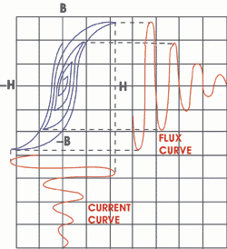
Magnetic Test Detail
Spacecraft Magnetic Control
The principles of demagnetizing
Using the periodically sinusoidal decreasing external magnetic field to reduce the magnetic hysteresis loops to demagnetize the material's saturation remanent flux, also to disarrange the orientation of material's magnetic domain. The maximum magnitude of the initial external magnetic field intensity must be larger than the material's maximum coercive force.
Periodically sinusoidal field B

Slide 43
Magnetic Test Detail
Spacecraft Magnetic Control
Method of magnetic compensation
Magnetic Compensation
The Compensation of satellite residual magnetic moment using permanent magnets made of ferromagnetic materials such ad Sm-Co, Nd-Fe-B etc.
Notes:
Samarium-cobalt alloy ,Neodymium-iron-boron alloy

Slide 44
Content
What's magnetic
Earth's magnetic field
Magnetic Test Detail
Magnetic Test Example
Exercise

Slide 45

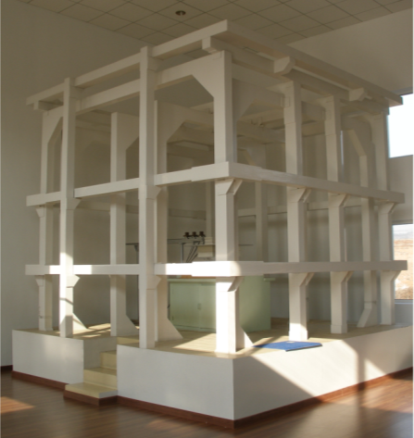
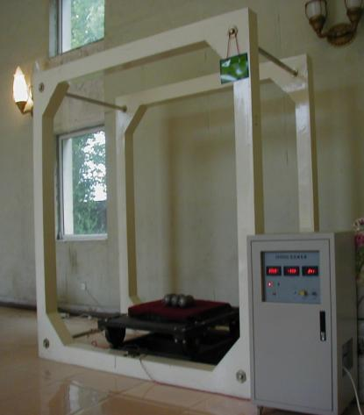
Magnetic Test Example
Spacecraft Magnetic Control
CM1
Magnetic test
in unit level
Mass: less than 100kg
Dimension: less than 1m
Item: magnetic field/moment, magnetizing/demagnetizing, compensation
Implement: units with magnetic control requirement
部组件级磁
试验
CM1 Zero magnetic test device
CM1A Zero magnetic test device
Magnetizing/demagnetizing device

Slide 46

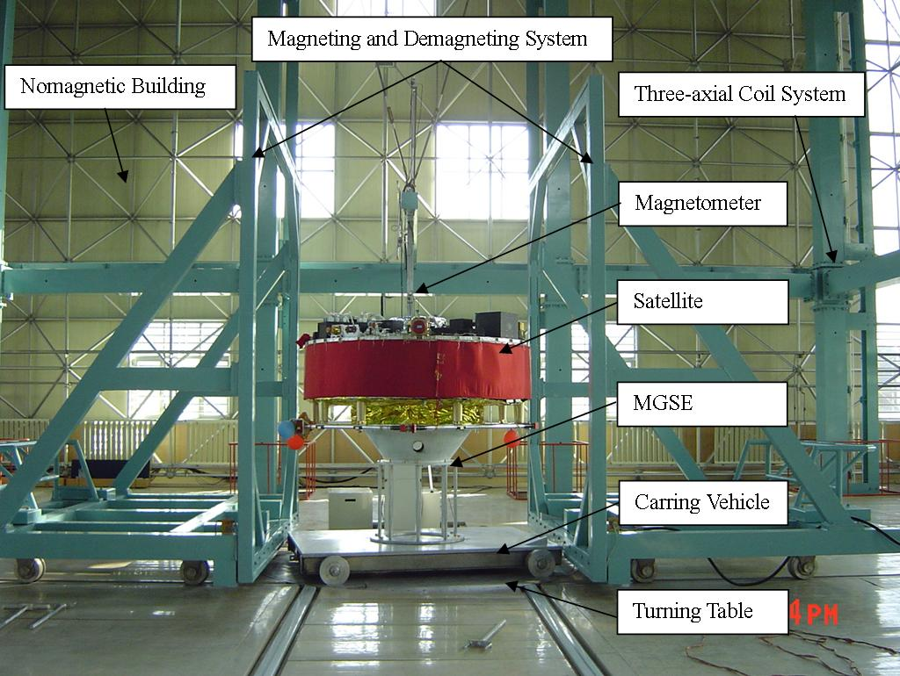
Magnetic Test Example
Spacecraft Magnetic Control
Facility for magnetic test
CM2
Magnetic test
in system level
Mass: less than 5000kg
Dimension: less than 5m
Item: magnetic field/moment, magnetizing/demagnetizing, compensation
Implement: LEO spacecraft, Planetary Science Explore Satellite
Nonmagnetic Laboratory
Main Coil System

Slide 47
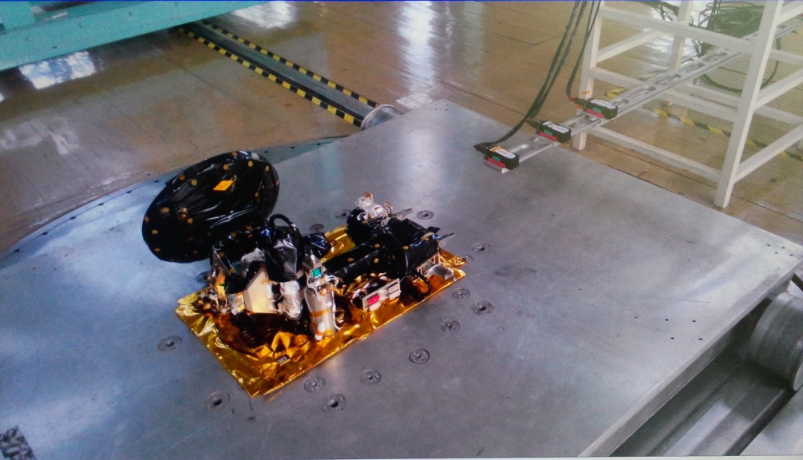
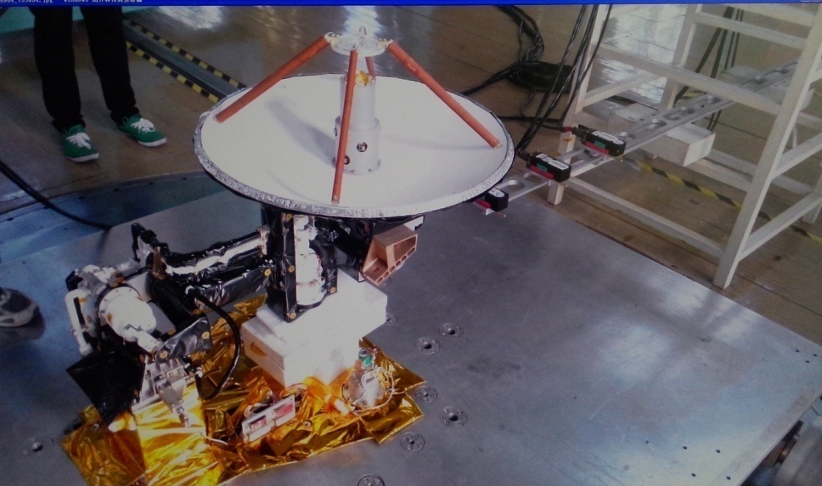
Magnetic Test Example
Magnetic Test Example
Magnetic test of a deployable antenna with rotation motors on joints.
Test conditions: deployed or impacted
Power status: power on or off, the direction of motors
Compensation: permanent magnet affixed near the motors

Slide 48
Magnetic Test Example
Magnetic Test Example
Magnetic test of a small satellite with solar cells attached on the satellite’s surface .
Test conditions: different working mode of the satellite
Power status: devices with
power on or off
Compensation: permanent
magnet affixed on the
surface of the satellite.

Slide 49
Content
What's magnetic
Earth's magnetic field
Magnetic Test Detail
Magnetic Test Example
Exercise

Slide 50
Exercise
Question1: What is magnetism?
Question2: What is the purpose of magnetic test?
Question3: What is the procedure of magnetic test?
Question4: How to Control and Minimization of Magnetic Disturbance?

Slide 51
Test design
Thank you !

